Slide 1
Pattern Recognition (EE5907) Asst Prof. Mike Shou

Slide 2
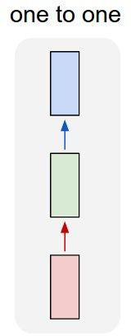
“Vanilla” Neural Network
Vanilla Neural Networks

Slide 3
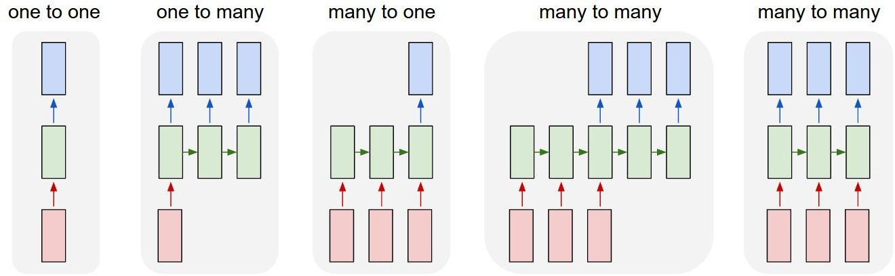
Recurrent Neural Networks: Process Sequences
e.g. Image Captioning
image -> sequence of words

Slide 4
Recurrent Neural Networks: Process Sequences
e.g. Sentiment Classification
sequence of words -> sentiment

Slide 5
Recurrent Neural Networks: Process Sequences
e.g. Machine Translation
seq of words -> seq of words

Slide 6
Recurrent Neural Networks: Process Sequences
e.g. Video classification on frame level

Slide 7
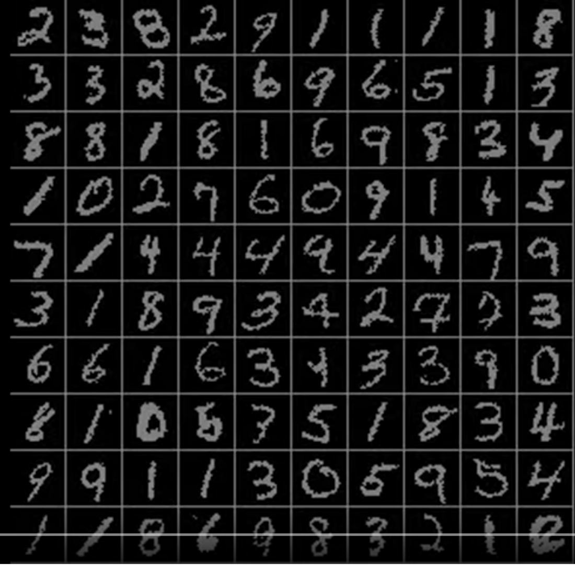
Sequential Processing of Non-Sequence Data
Classify images by taking a series of “glimpses”
Ba, Mnih, and Kavukcuoglu, “Multiple Object Recognition with Visual Attention”, ICLR 2015. Gregor et al, “DRAW: A Recurrent Neural Network For Image Generation”, ICML 2015
Figure copyright Karol Gregor, Ivo Danihelka, Alex Graves, Danilo Jimenez Rezende, and Daan Wierstra,
2015. Reproduced with permission.

Slide 8
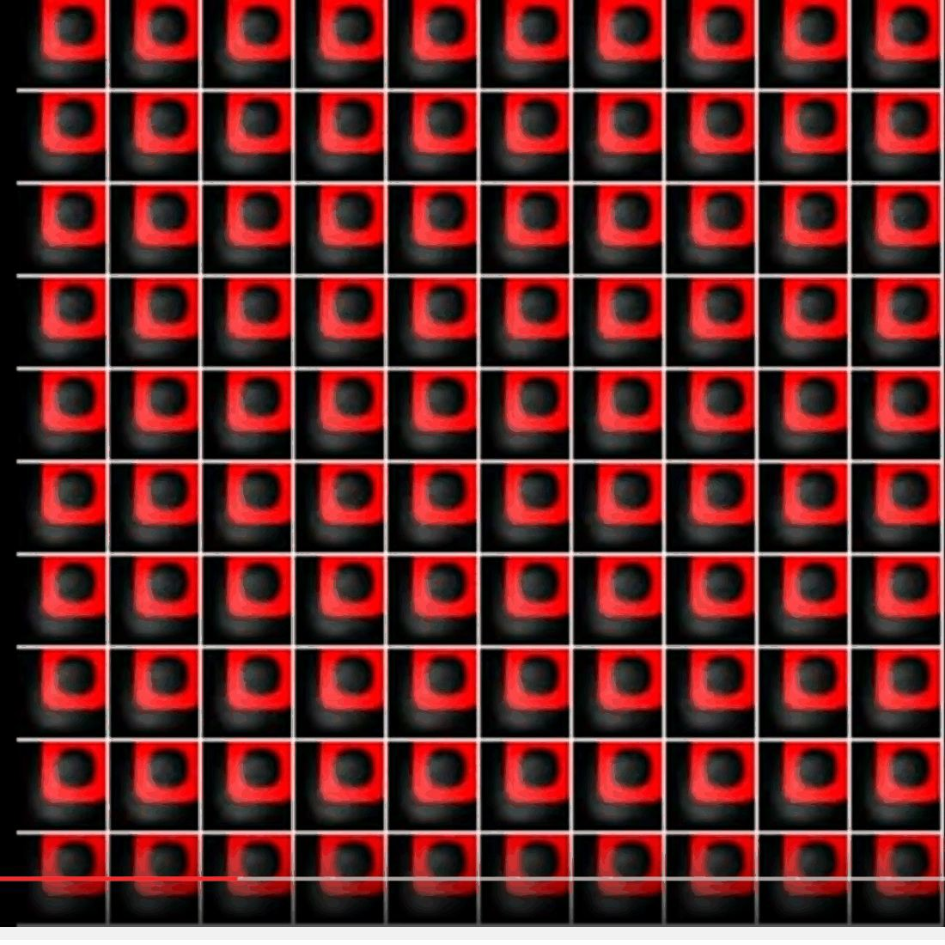
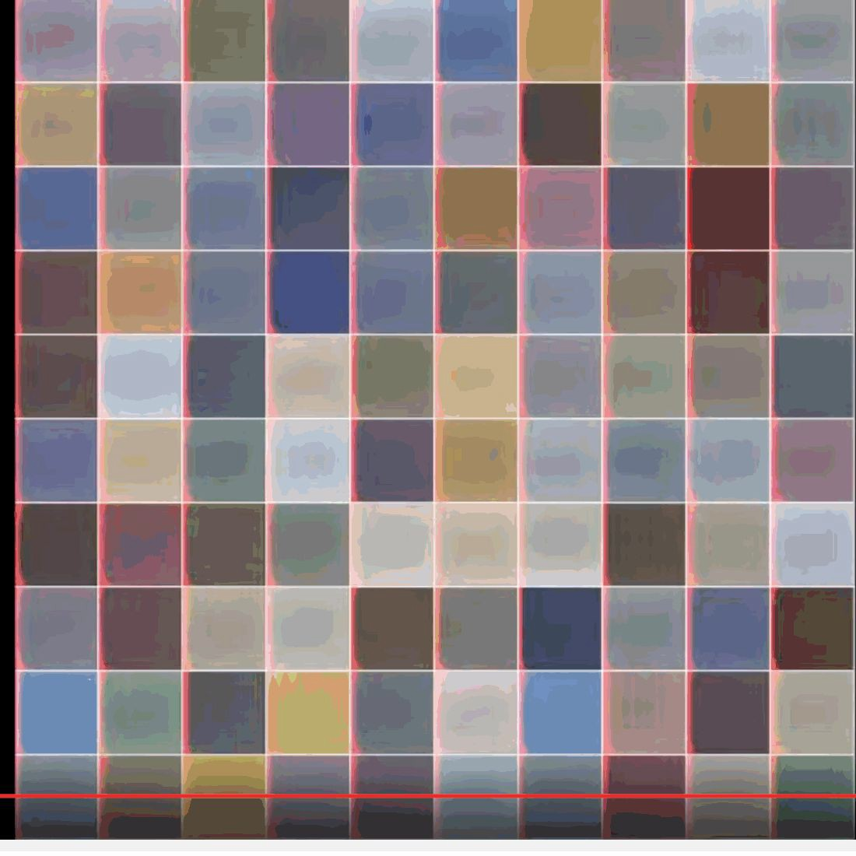
Sequential Processing of Non-Sequence Data
Generate images one piece at a time!
Gregor et al, “DRAW: A Recurrent Neural Network For Image Generation”, ICML 2015
Figure copyright Karol Gregor, Ivo Danihelka, Alex Graves, Danilo Jimenez Rezende, and Daan Wierstra, 2015. Reproduced with permission.

Slide 9
Recurrent Neural Network
RNN
x

Slide 10
Recurrent Neural Network
y
usually want to predict a vector at some time steps
RNN
x

Slide 11
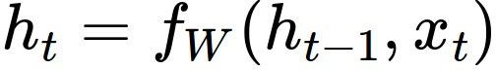
Recurrent Neural Network
We can process a sequence of vectors x by applying a recurrence formula at every time step:
y
RNN
new state old state input vector at
some time step
x
some function
with parameters W

Slide 12
Recurrent Neural Network
We can process a sequence of vectors x by applying a recurrence formula at every time step:
y
RNN
x
Notice: the same function and the same set of parameters are used at every time step.

Slide 13
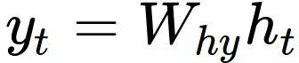
(Simple) Recurrent Neural Network
The state consists of a single “hidden” vector h:
y
RNN
x
Sometimes called a “Vanilla RNN” or an “Elman RNN” after Prof. Jeffrey Elman

Slide 14
RNN: Computational Graph
h₀
h₁
f_{W}
x₁

Slide 15
RNN: Computational Graph
h₀
h₁
h₂
f_{W}
f_{W}
x₁
x₂

Slide 16
RNN: Computational Graph
h₀
h₁
h₂
h₃
…
h_{T}
f_{W}
f_{W}
f_{W}
x₁
x₂
x₃

Slide 17
RNN: Computational Graph
Re-use the same weight matrix at every time-step
h₂
h₃
…
h_{T}
h₀
f_{W}
h₁
f_{W}
f_{W}
x₁
x₂
x₃
W

Slide 18
RNN: Computational Graph: Many to Many
y₁
y₂
y₃
y_{T}
h₂
h₃
…
h_{T}
h₀
f_{W}
h₁
f_{W}
f_{W}
x₁
x₂
x₃
W

Slide 19
RNN: Computational Graph: Many to Many
y₁
y₂
y₃
y_{T}
L₁
L₂
L₃
L_{T}
h₂
h₃
…
h_{T}
h₀
f_{W}
h₁
f_{W}
f_{W}
x₁
x₂
x₃
W

Slide 20
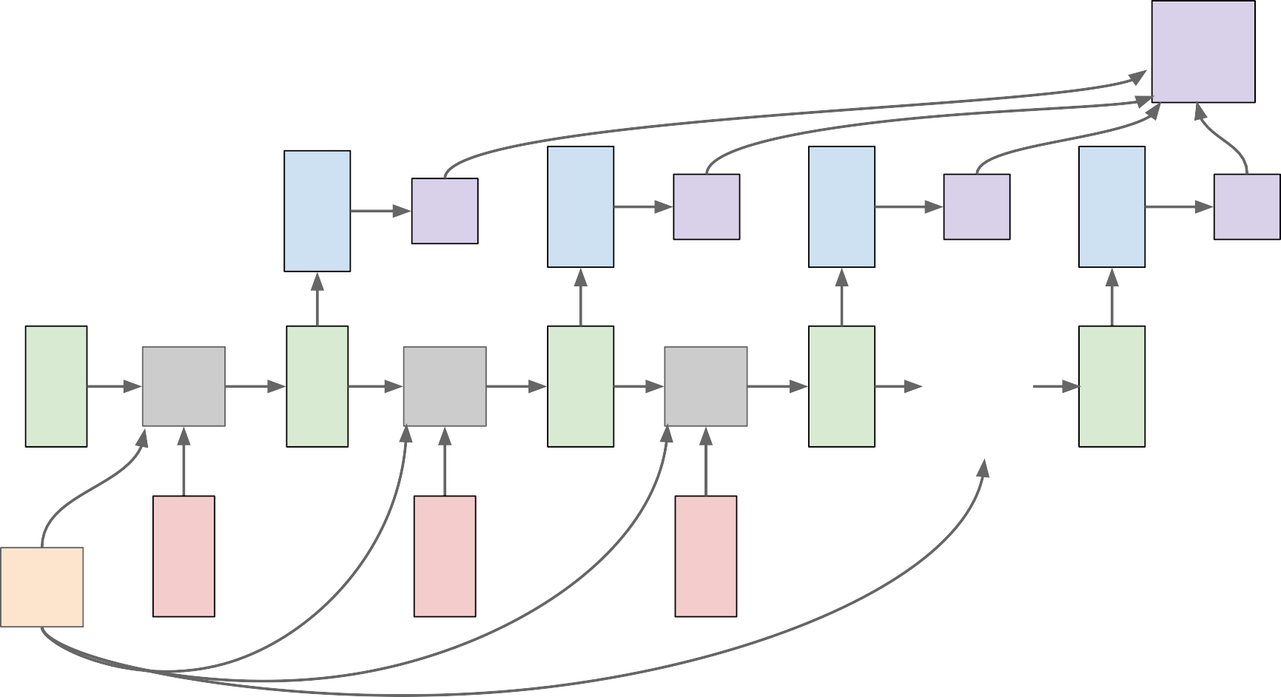
RNN: Computational Graph: Many to Many
L
 | y₁ | L₁ | y₂ | L₂ | y₃ | L₃ | y_{T} | L_{T}
f_{W} x₁ | h₁ | f_{W} x₂ | h₂ | f_{W} x₃ | h₃ | … | h_{T}
h₀
W

Slide 21
RNN: Computational Graph: Many to One
y
h₂
h₃
…
h_{T}
h₀
f_{W}
h₁
f_{W}
f_{W}
x₁
x₂
x₃
W

Slide 22
RNN: Computational Graph: One to Many
y₁
y₂
y₃
y_{T}
h₂
h₃
…
h_{T}
h₀
f_{W}
h₁
f_{W}
f_{W}
x
W

Slide 23
Sequence to Sequence: Many-to-one + one-to-many
Many to one: Encode input sequence in a single vector
h
0
f_{W}
h
1
f_{W}
h
2
f_{W}
h
3
…
h
T
x
1
x
2
x
3
W
1
Sutskever et al, “Sequence to Sequence Learning with Neural Networks”, NIPS 2014

Slide 24
Sequence to Sequence: Many-to-one + one-to-many
One to many: Produce output sequence from single input vector
Many to one: Encode input
sequence in a single vector
y
1
y
2
h
0
f_{W}
h
1
f_{W}
h
2
f_{W}
h
3
…
h
T
h
1
h
2
…
f_{W}
f_{W}
f_{W}
x
1
x
2
x
3
W
W
1
2
Sutskever et al, “Sequence to Sequence Learning with Neural Networks”, NIPS 2014

Slide 25
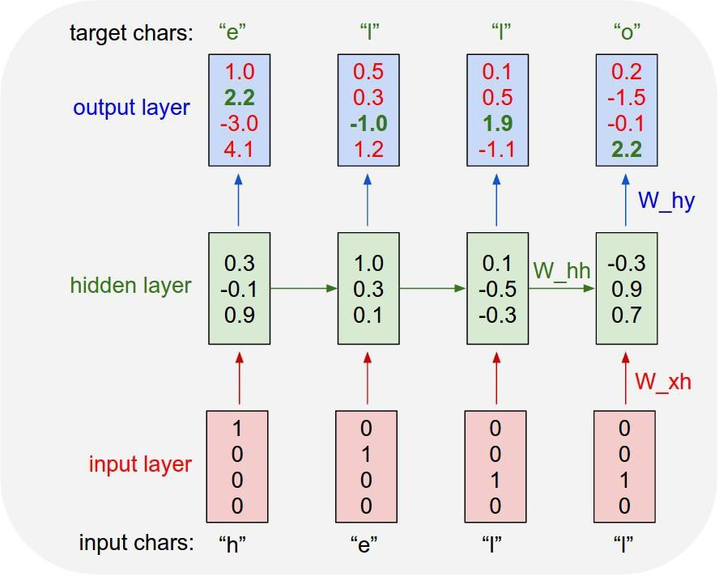
Example: Character-level Language Model
Vocabulary: [h,e,l,o]
Example training sequence: “hello”

Slide 26
Example: Character-level Language Model
Vocabulary: [h,e,l,o]
Example training sequence: “hello”

Slide 27
Example: Character-level Language Model
Vocabulary: [h,e,l,o]
Example training sequence: “hello”

Slide 28
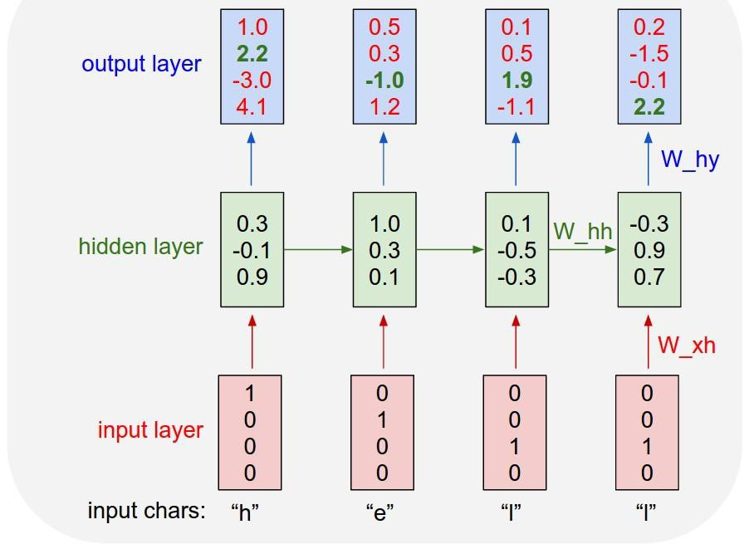
Example: Character-level Language Model Sampling
“e”
“l”
.25
.20
.05
.50
“l” “o”
.11 .11
.17 .02
.68 .08
.03 .79
Sample
.03
.13
.00
.84
Softmax
Vocabulary: [h,e,l,o]
At test-time sample characters one at a time, feed back to model

Slide 29
Example: Character-level Language Model Sampling
“e”
“l”
.25
.20
.05
.50
“l” “o”
.11 .11
.17 .02
.68 .08
.03 .79
Sample
.03
.13
.00
.84
Softmax
Vocabulary: [h,e,l,o]
At test-time sample characters one at a time, feed back to model

Slide 30
Example: Character-level Language Model Sampling
“e”
“l”
“l” “o”
.11 .11
.17 .02
.68 .08
.03 .79
Sample
.03
.13
.00
.84
.25
.20
.05
.50
Softmax
Vocabulary: [h,e,l,o]
At test-time sample characters one at a time, feed back to model

Slide 31
Example: Character-level Language Model Sampling
“e” |  | “l” |  | “l” |  | “o”
.03 |  | .25 |  | .11 |  | .11
.13 |  | .20 |  | .17 |  | .02
.00 |  | .05 |  | .68 |  | .08
.84 |  | .50 |  | .03 |  | .79
Sample
Softmax
Vocabulary: [h,e,l,o]
At test-time sample characters one at a time, feed back to model

Slide 32


Backpropagation through time
Forward through entire sequence to compute loss, then backward through entire sequence to compute gradient
Loss

Slide 33
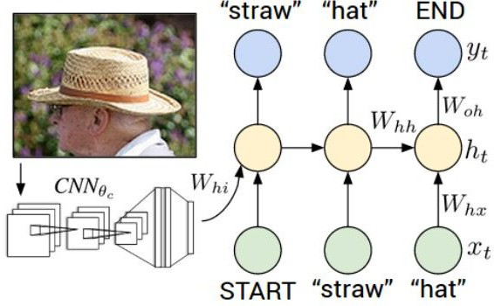
Image Captioning
Figure from Karpathy et a, “Deep
Visual-Semantic Alignments for Generating Image Descriptions”, CVPR 2015; figure copyright IEEE, 2015.
Reproduced for educational purposes.
Explain Images with Multimodal Recurrent Neural Networks, Mao et al.
Deep Visual-Semantic Alignments for Generating Image Descriptions, Karpathy and Fei-Fei Show and Tell: A Neural Image Caption Generator, Vinyals et al.
Long-term Recurrent Convolutional Networks for Visual Recognition and Description, Donahue et al. Learning a Recurrent Visual Representation for Image Caption Generation, Chen and Zitnick

Slide 34
Recurrent Neural Network
Convolutional Neural Network

Slide 35

test image
This image is CC0 public domain

Slide 36
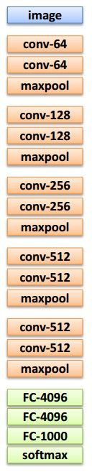
test image

Slide 37
test image
X

Slide 38
test image
x0
<STA RT>
<START>

Slide 39

test image
y0
before:
h = tanh(Wxh * x + Whh * h)
h0
Wih
now:
h = tanh(Wxh * x + Whh * h + Wih * v)
x0
<STA RT>
v
<START>

Slide 40
test image
y0
h0
sample!
x0
<STA RT>
straw
<START>

Slide 41
test image
y0
y1
h0
h1
x0
<STA RT>
straw
<START>

Slide 42
test image
y0
y1
h0
h1
sample!
x0
<STA RT>
straw
hat
<START>

Slide 43
test image
y0
y1
y2
h0
h1
h2
x0
<STA RT>
straw
hat
<START>

Slide 44
test image
y0
y1
y2
sample
<END> token
=> finish.
h0
h1
h2
x0
<STA RT>
straw
hat
<START>

Slide 45
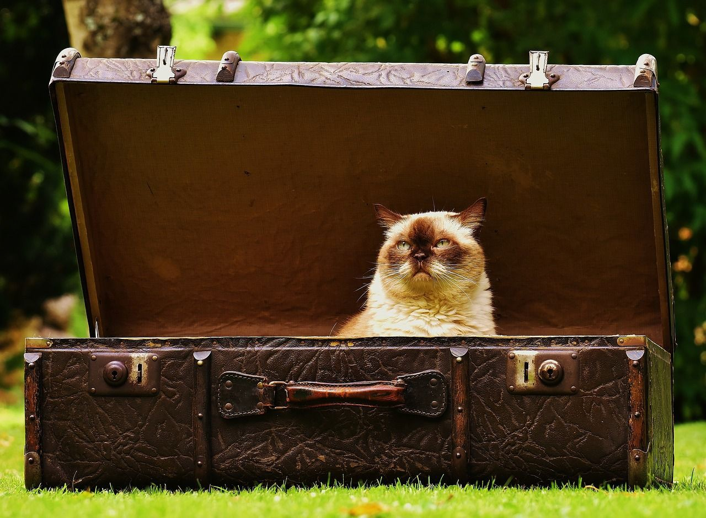
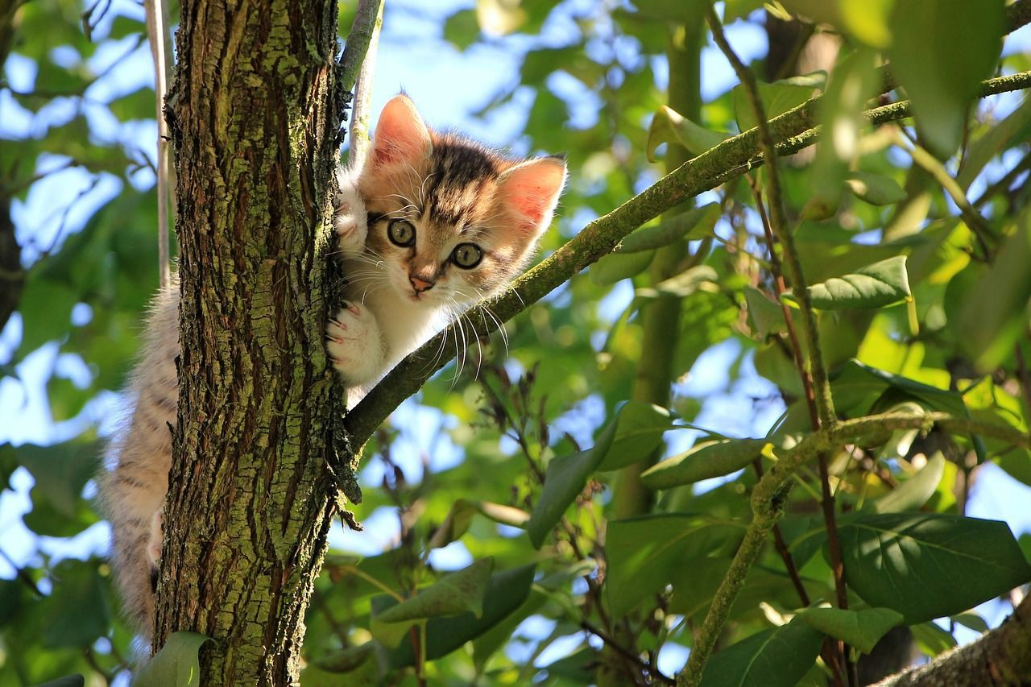
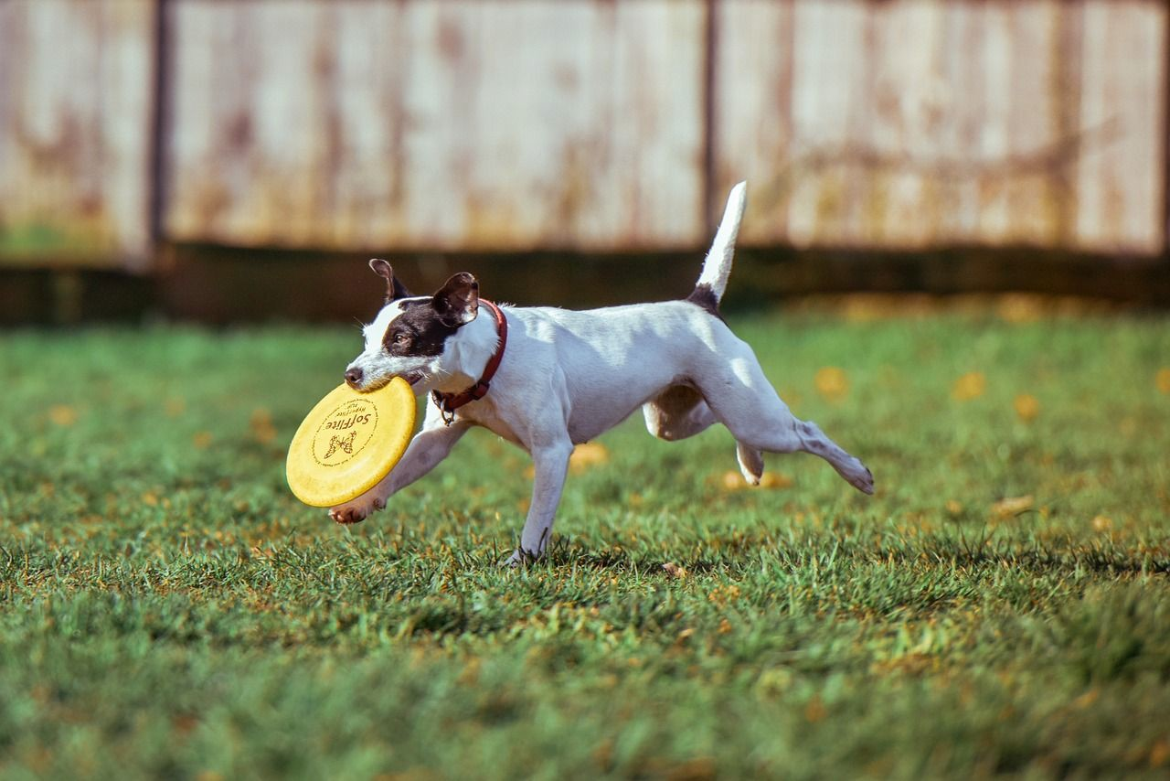
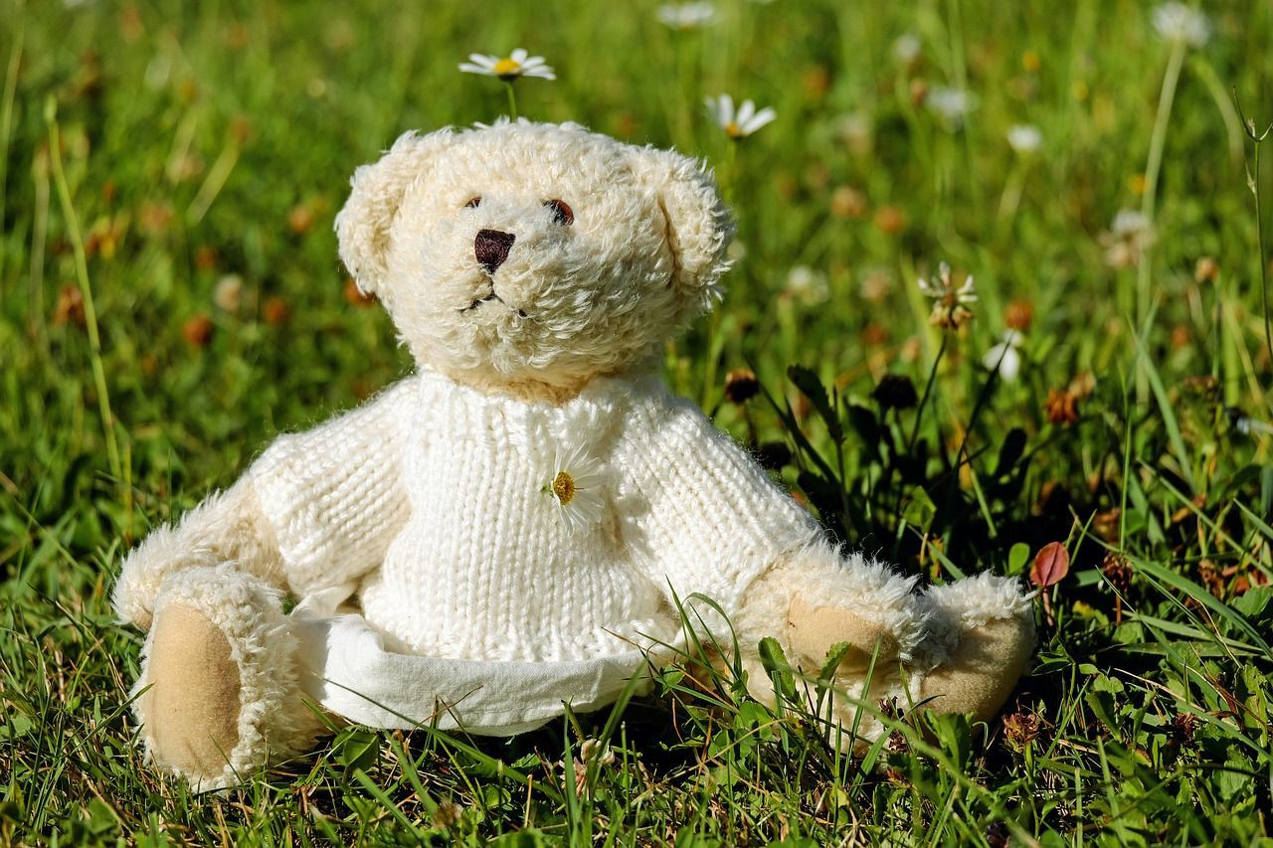
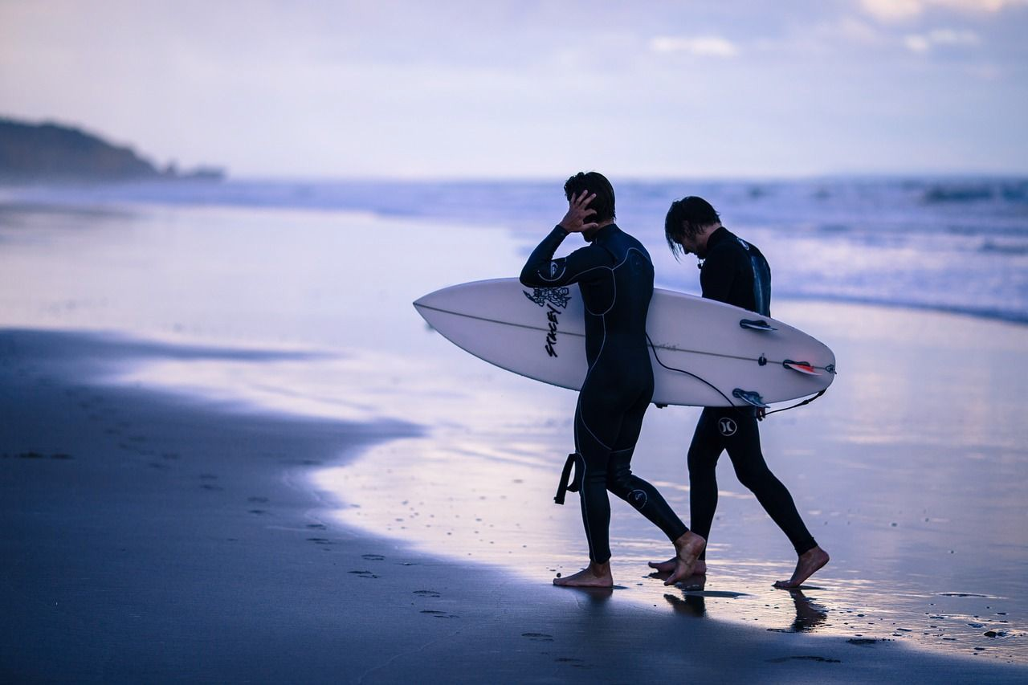
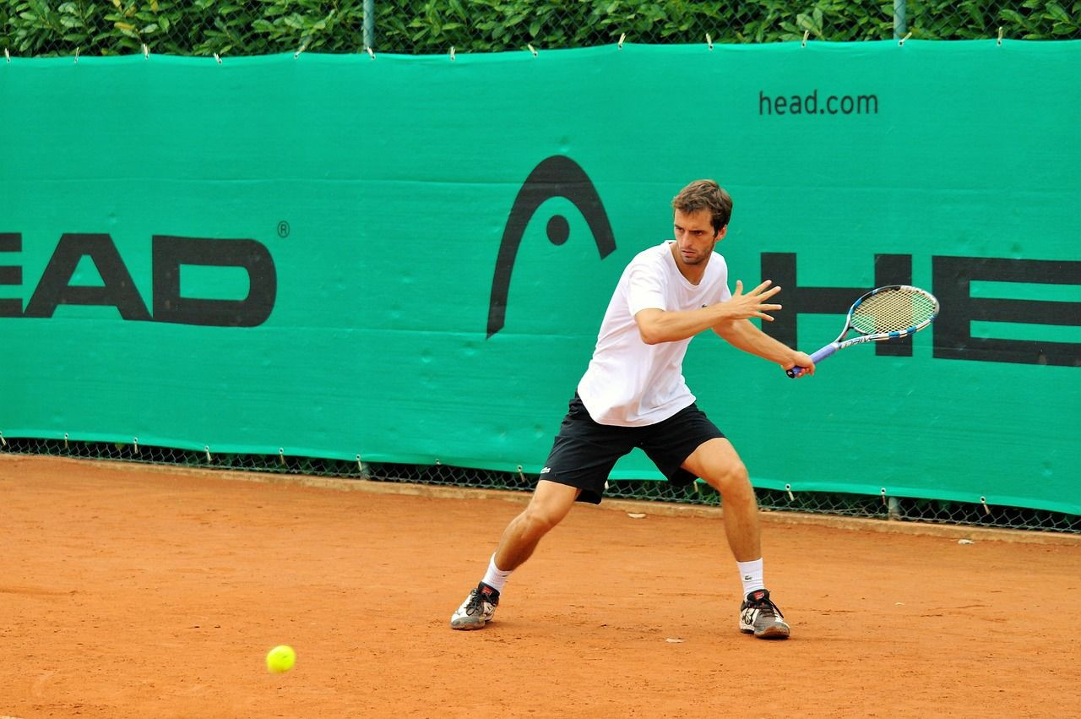
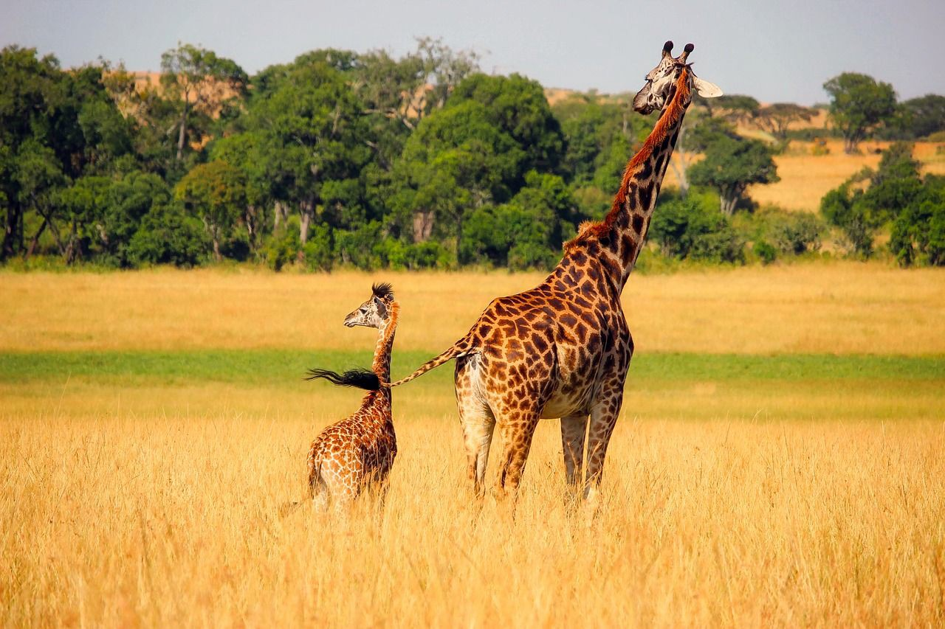
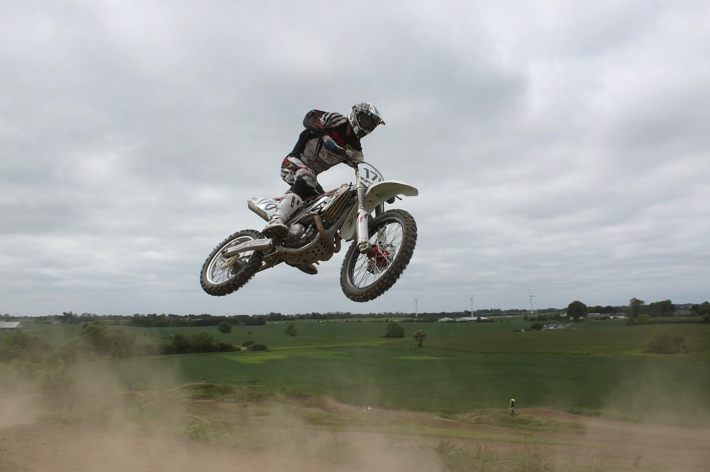
Image Captioning: Example Results
Captions generated using neuraltalk2 All images are CC0 Public domain:
cat suitcase, cat tree, dog, bear,
surfers, tennis, giraffe, motorcycle
A cat sitting on a suitcase on the floor
A cat is sitting on a tree branch
A dog is running in the grass with a frisbee
A white teddy bear sitting in the grass
Two people walking on the beach with surfboards
A tennis player in action on the court
Two giraffes standing in a grassy field
A man riding a dirt bike on a dirt track

Slide 46
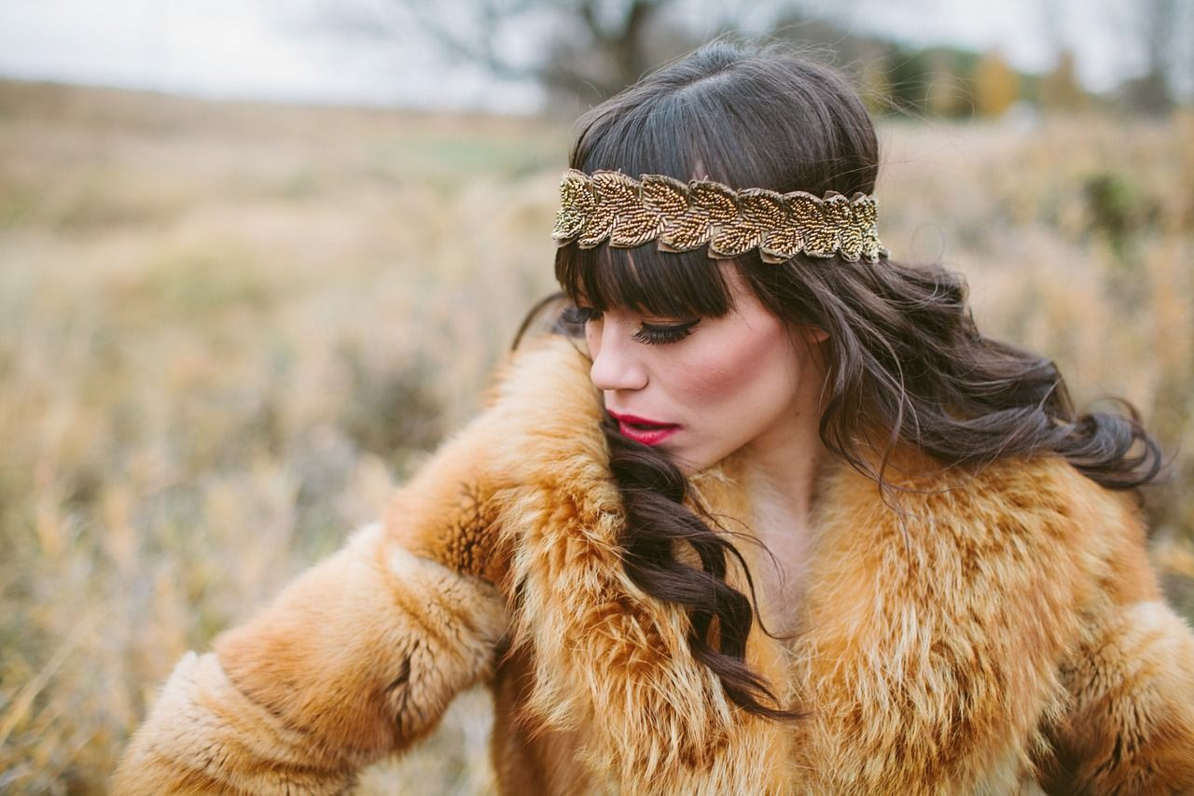
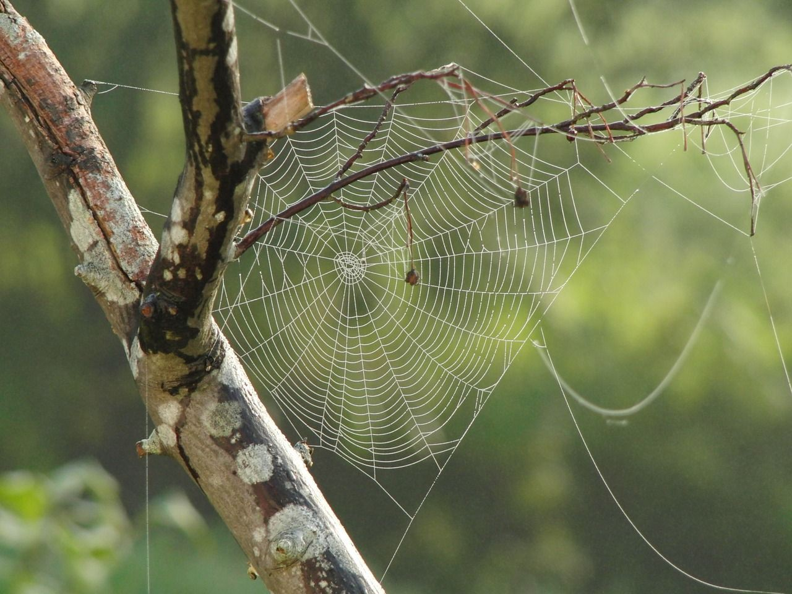
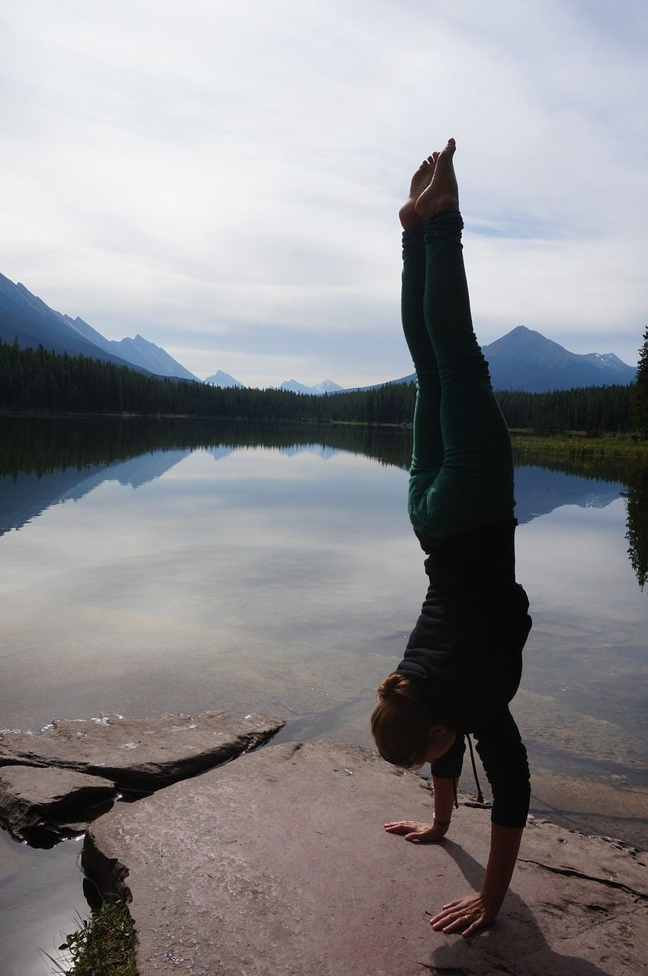

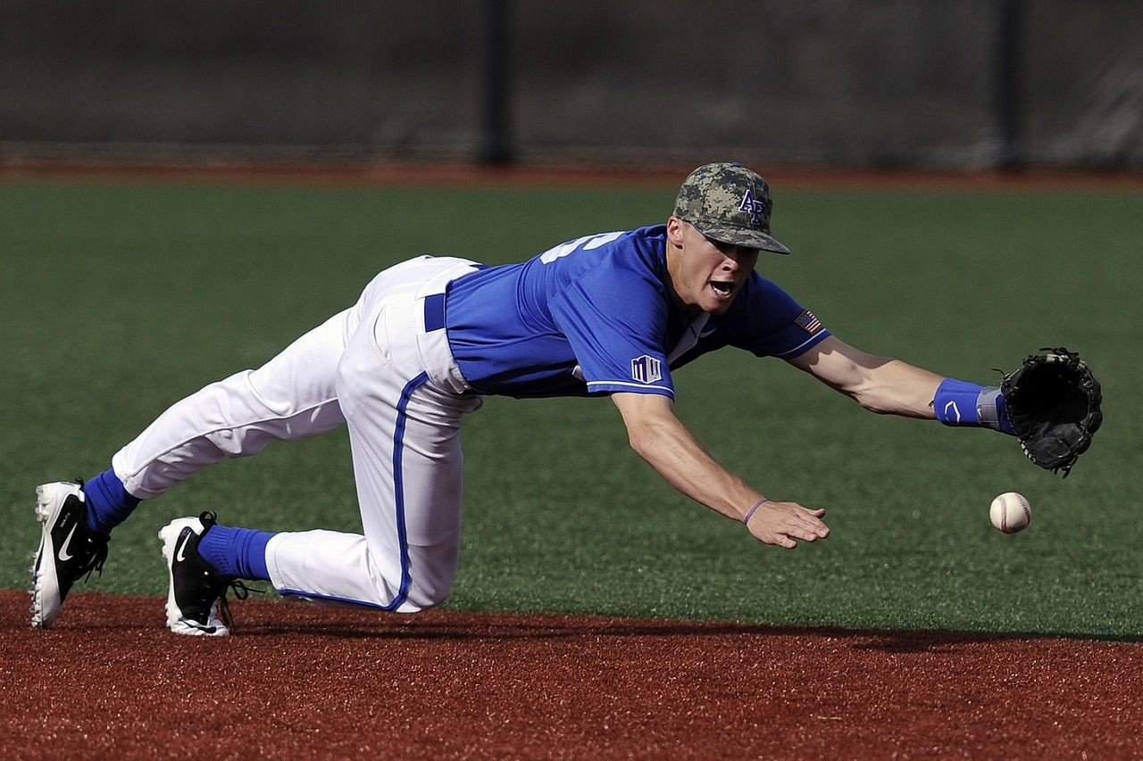
Image Captioning: Failure Cases
Captions generated using neuraltalk2 All images are CC0 Public domain: fur coat, handstand, spider web, baseball
A bird is perched on a tree branch
A woman is holding a cat in her hand
A man in a baseball uniform throwing a ball
A woman standing on a beach holding a surfboard
A person holding a computer mouse on a desk

Slide 47
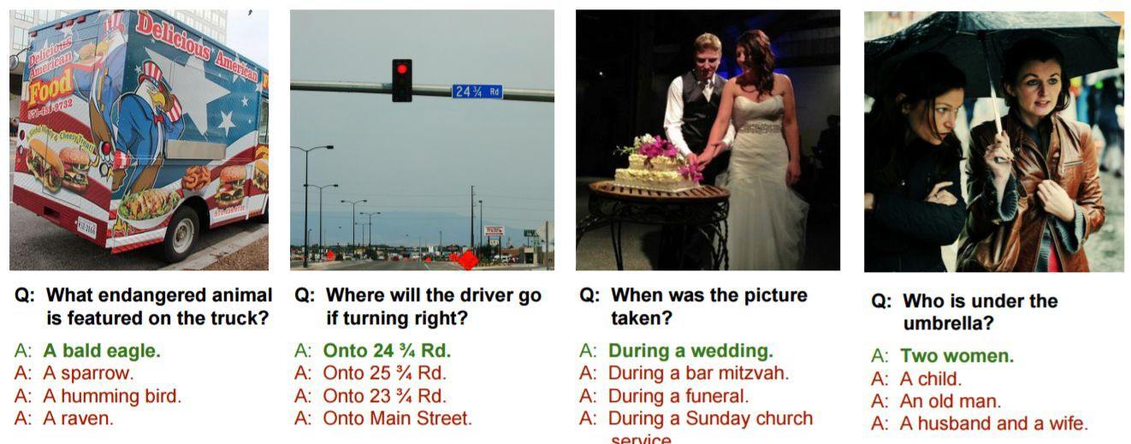
Visual Question Answering
Agrawal et al, “VQA: Visual Question Answering”, ICCV 2015
Zhu et al, “Visual 7W: Grounded Question Answering in Images”, CVPR 2016
Figure from Zhu et al, copyright IEEE 2016. Reproduced for educational purposes.

